Slide 1

JSPM’s Jayawantrao Sawant Polytechnic, Hadapsar,
Pune
Name of Student : Saurabh Rajpoot
Project Title :
Automatic Timetable Generator Windows Application Using C#

Slide 2
INDEX
Abstract.
Introduction
Literature Survey
Scope of the Project
Hardware & Software Requirement
Advantages
Disadvantages
Applications
Future Scope
Conclusion
References

Slide 3
ABSTRACT
Time table generation is tedious job for educationalist with respect to time and man power.
Providing a automatic time table generator will help to generate time table automatically.
Proposed system of our project will help to generate it automatically also helps to save time.
It avoids the complexity of setting and managing Timetable manually. In our project we are going to use algorithms like genetic resource scheduling to reduce these difficulties of generating timetable.
These algorithms incorporate a numeral of strategy, aimed to improve the operativeness of the search operation. The system will take various inputs like number of subjects, teachers, workload of a teacher, semester, rooms, labs.
By relying on these inputs, it will generate possible time tables for working days of the week for teaching faculty.
This will integrate by making optimal use of all resources in a way that will best suit the constraints.

Slide 4
INTRODUCTION
Although majority college organization work has been mechanized, the lecture timetable preparation is still commonly done by hand due to its inherent diﬃculties.
The physical lecture-timetable preparation demands significant time and eﬀorts.
The manual lecture-timetable scheduling is a limitation fulfillment problem in which we ﬁnd a result that satisﬁes the given set of constraints.
There have been numerals of approaches made in the earlier period to the difficulty of constructing timetables for colleges and schools.
Timetabling problems may be solve by diverse methods inherited from operation study such as graph coloring, local search measures such as tabu search, simulated annealing, genetic algorithms or from backtracking based constraint fulfillment handling.
In our project, timetable problem is formulated as a constraint fulfillment problem and we proposed a realistic timetable algorithm which is capable of taking care of both hard and soft constraints.
It is a complete time table solution for Colleges which help to overcome the challenges in manually constructing the timetable.

Slide 5
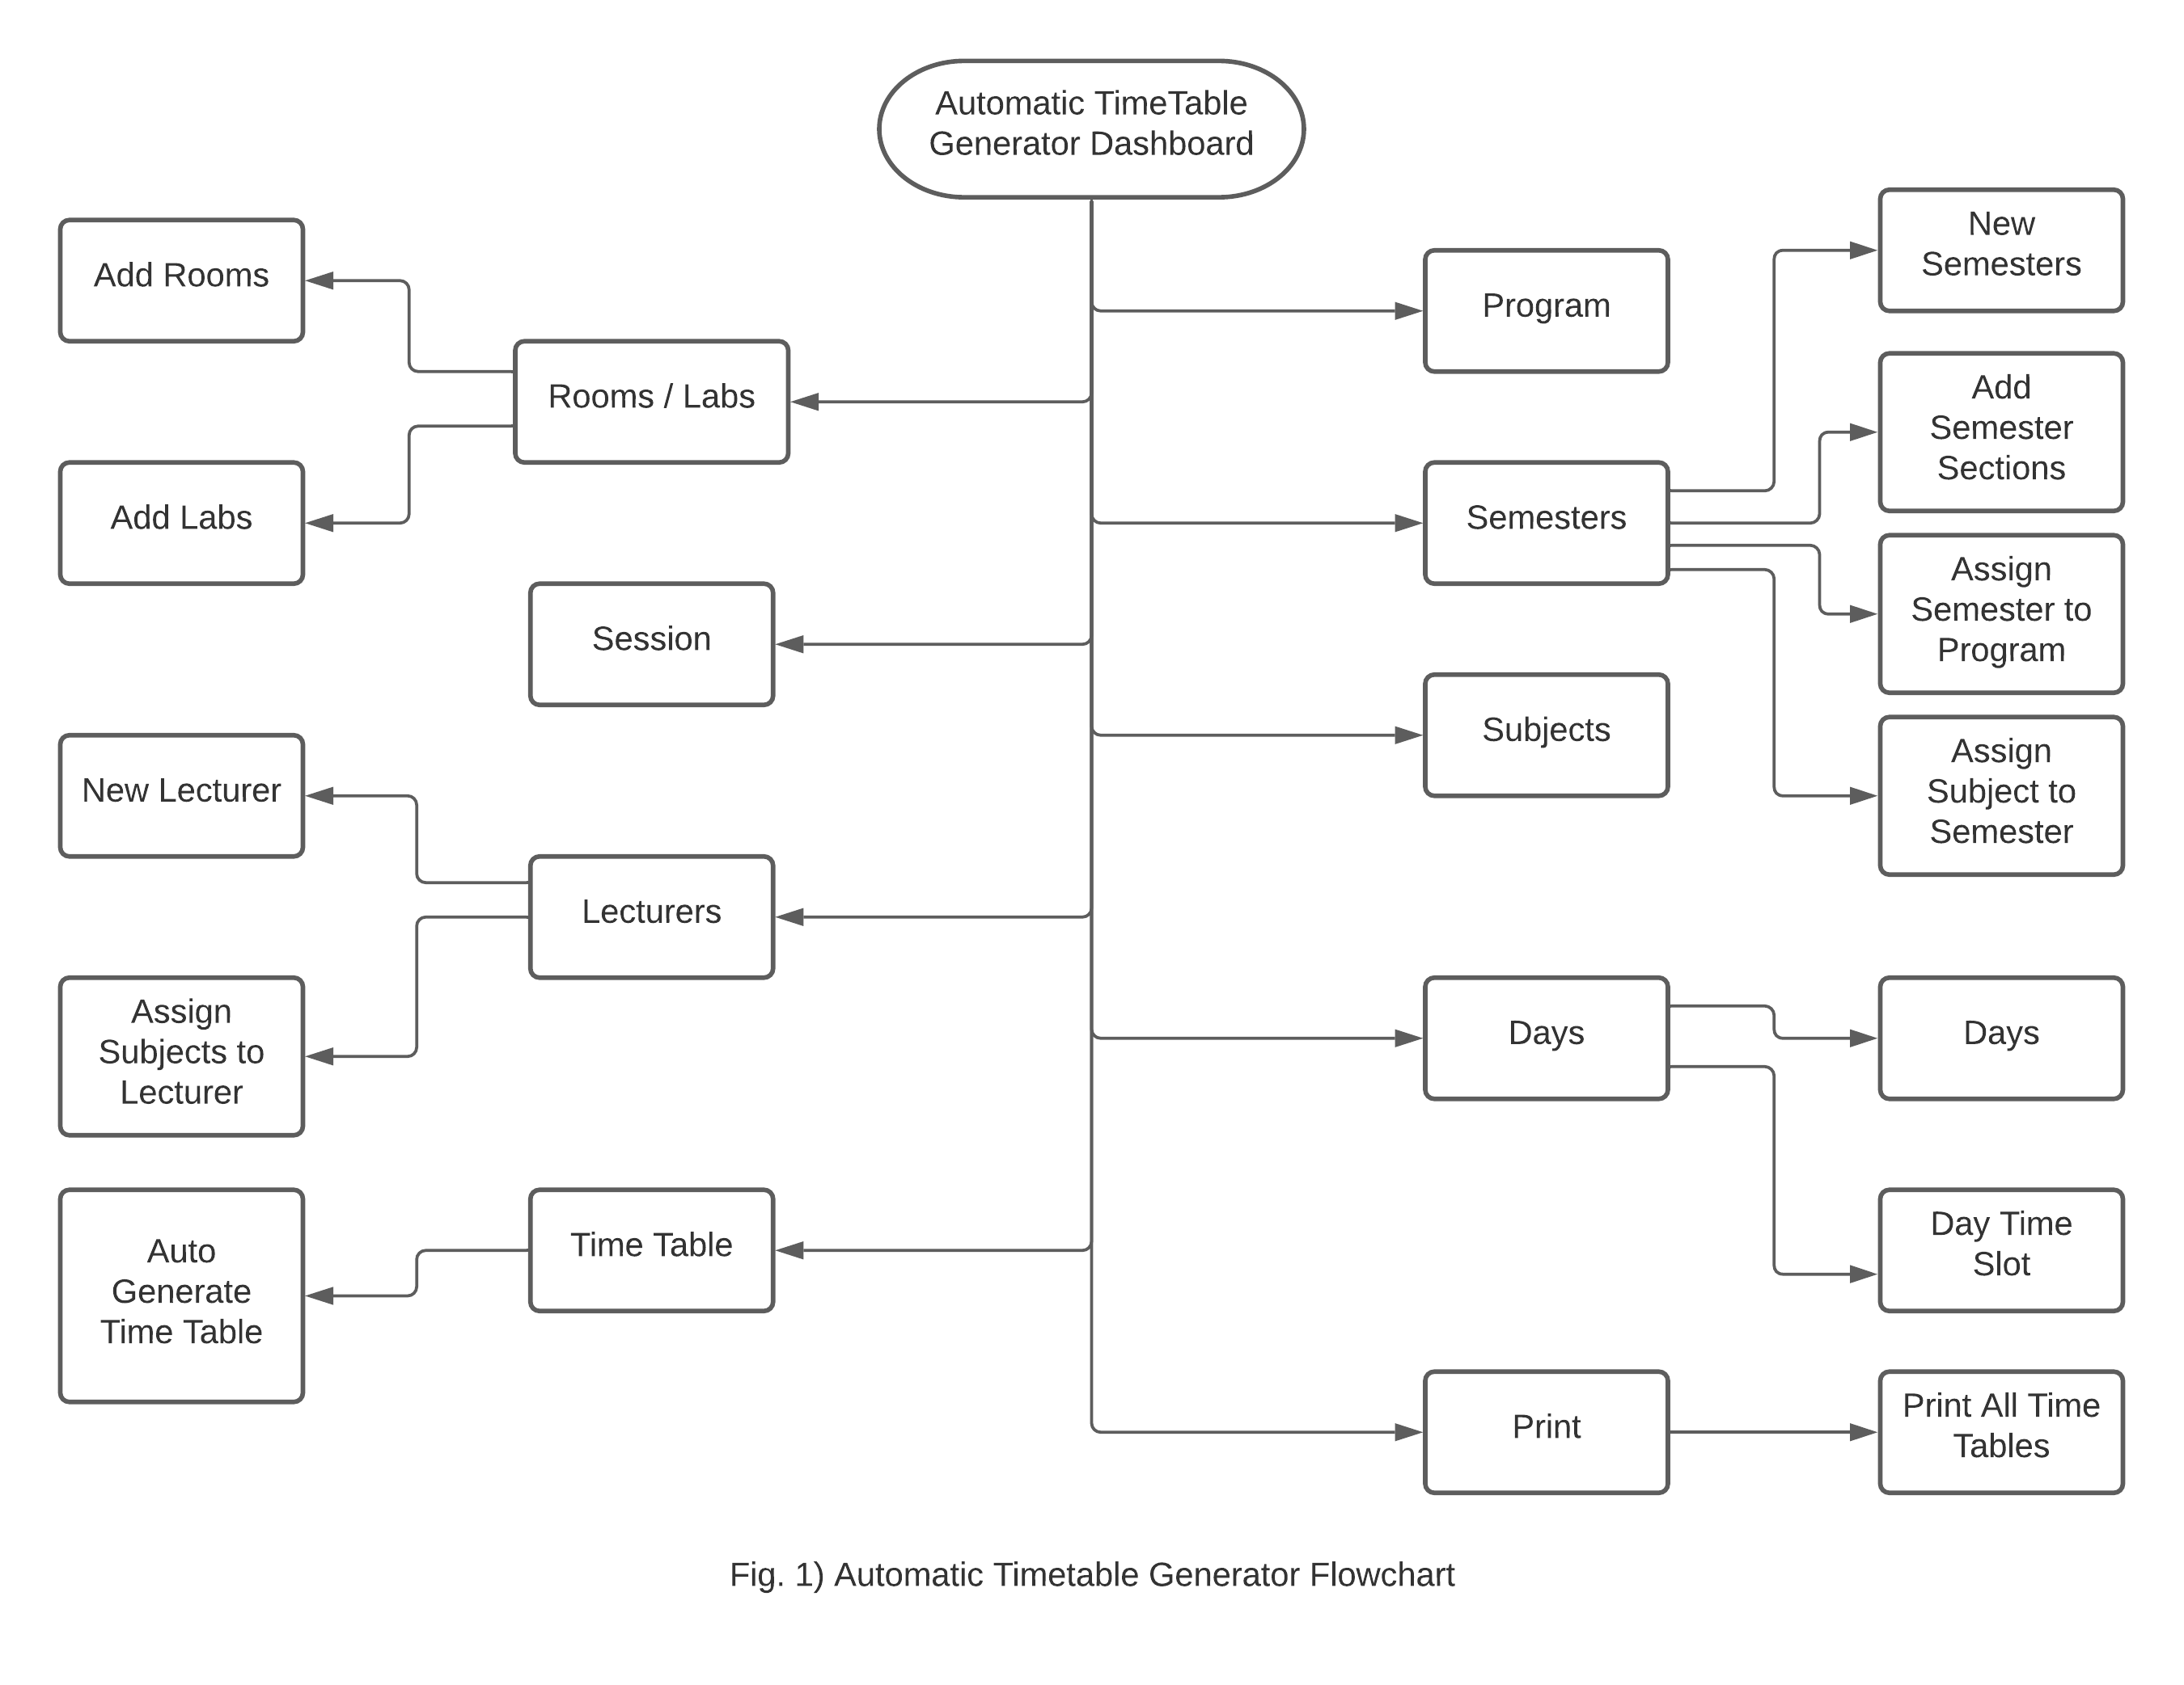

Slide 6
LITERATURE SURVEY
Research Paper Name | Author | Methodology | Drawbacks
A Literature Review on Timetable Generation Algorithms Published 19 January 2017 | S. Nangare | A lot of complex constraints need to be addressed for development of an efficient algorithm to solve this problem. There are still serious problems like generation of high cost time table. Therefore there is a great requirement for an application distributing the course evenly and without collisions. Our aim here is to develop a simple, easily understandable, efficient and portable application, which could automatically generate good quality time tables within seconds. | Long or Short Breaks between lectures is dynamic so we cant able to fix the breaks as per our convenience.

Slide 7
SCOPE OF THE PROJECT
Automatic Timetable Generator generates timetable for each class-wise and teacher-wise, in keeping with the availability calendar of teachers, availability and capacity of physical resources such as classrooms and rules applicable at different classes, semesters, teachers and subjects level. Best of all, this Timetable Generation System tremendously improves resource utilization and optimization.

Slide 8
HARDWARE & SOFTWARE REQUIREMENT
Hardware requirement :
• System: Pentium IV 2.4 GHz.
• Hard Disk :40 GB.
• RAM: 2 GB.
Software requirement :
• Operating system : Windows XP/7
• Coding Language: C#.
• IDE : Visual Basic.
• Front End: C#.
• Back End: SQL Server 2014 Management Studio

Slide 9
ADVANTAGES
Saves Time and Effort
Faculty did not need to worry for time clashes and teacher clashes.
Authority can concentrate on other things rather than wasting their time on preparing Time-Table
Secure and User-Friendly
Creating a paperless environment

Slide 10
DISADVANTAGES
It is complex to implement
It requires large amount of memory because the problem instances and best solution found so far has to be stored.

Slide 11
APPLICATIONS
• College
School
University

Slide 12
FUTURE SCOPE
With good data structures, it is possible to generate a set of equations that generate the timetable automatically, or can be used to check the manually generated timetable against the constraints.
Given the generality of the operation, it can further be adapted to more specific scenarios,
e.g. University, examination scheduling and further be enhanced to create railway time tables.
The most interesting future direction in the development of the project lies in its extension to constraint propagation.
Timetable management has been made easier with this solution. It includes a web app to generate timetable and push to android devices.

Slide 13
CONCLUSION
The intention of the project is to generate a time-table that can schedule automatically. Timetabling problem being the hard combinatorial problem that is would take more than just the application of only one principle.
This incorporates a number of techniques, aimed to improve the efficiency of scheduling. It also, addresses the important hard constraint of clashes between the availability of teachers.
The non-rigid soft constraints i.e. optimization objectives are also effectively handled.
Thus, through the process of automation of the time-table problem, many an-hours of creating an effective timetable have been reduced eventually.
By considering all these constraints effectively and efficiently a timetable can be generated which eventually can be used for a specific class of an institution and may also be saved for future.
This complete process of storing data of staff and subjects and retrieving them by timetable generation part uses database and thus generates a well scheduled timetable by considering the above constraints.

Slide 14
REFERENCES
[1] M. Doulaty, M. R. Feizi Derakhshi, and M. Abdi, “Timetabling: A State-of-the-Art Evolutionary Approach”, International Journal of Machine Learning and Computing, Vol. 3, No. 3, June 2013.
[2] Anirudha Nanda, Manisha P. Pai, and Abhijeet Gole, “An Algorithm to Automatically Generate Schedule for School Lectures Using a Heuristic Approach”, International Journal of Machine Learning and Computing, Vol. 2, No. 4, August 2012
[3] Dilip Datta, Kalyanmoy Deb, Carlos M. Fonseca, “Solving Class Timetabling Problem of IIT Kanpur using Multi-Objective Evolutionary Algorithm”.KanGAL 2005.
[4] Anuja Chowdhary, Priyanka Kakde, Shruti Dhoke, Sonali Ingle,Rupal Rushiya, Dinesh Gawande, 'Time table Generation System”, International Journal of Computer Science and Mobile Computing, Vol.3 Issue.2, February- 2014.
[5] Mughda Kishor Patil, Rakhe Shruti Subodh, Prachi Ashok Pawar, Naveena Narendra Singh Turkar, “Web Application for Automatic Time Table Generation”, International Journal of current Engineering and Technology, E-ISSN 2277-4106, P-ISSN 2347-5161.

Slide 15
Thank You
Any Questions?

